Slide 1


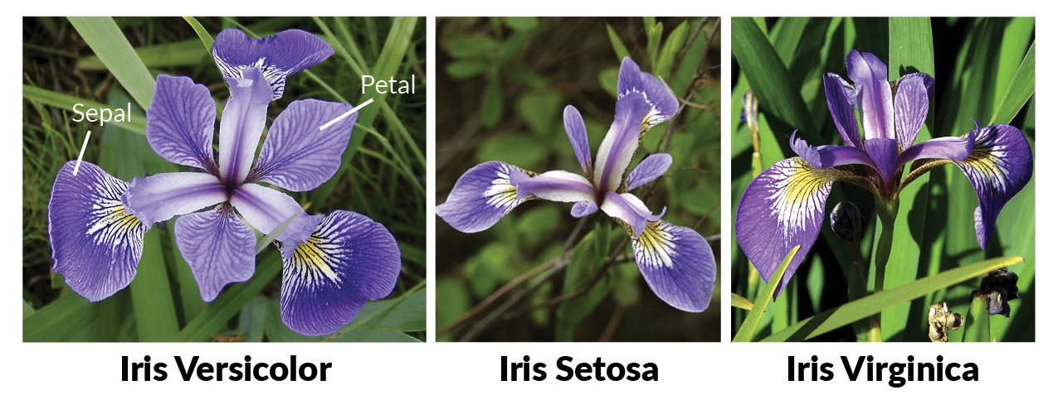
IRIS DATA ANALYSIS

Slide 2
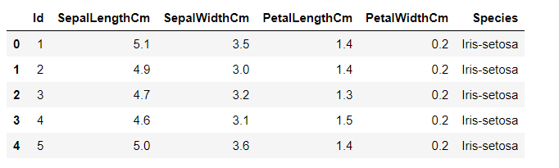
Let's Understand the Data

Slide 3
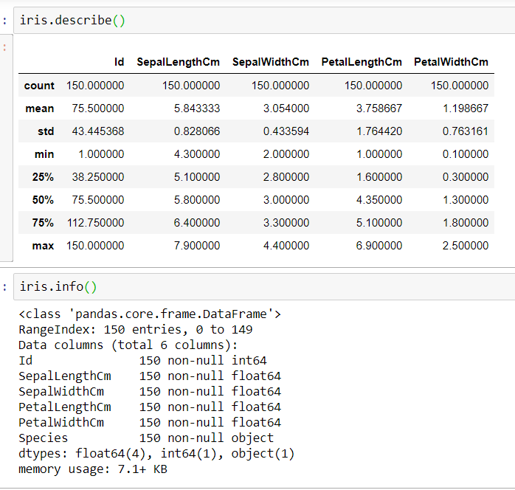
Data Summary

Slide 4

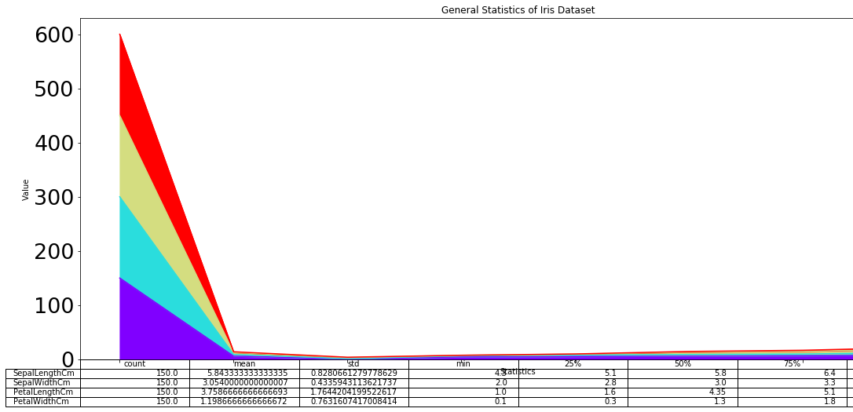



Data Summary

Slide 5
Exploratory Data Analysis

Slide 6
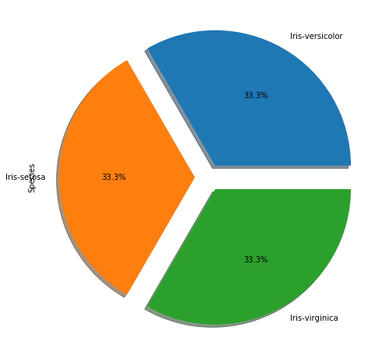
Exploratory Data Analysis – Pie Chart

Slide 7
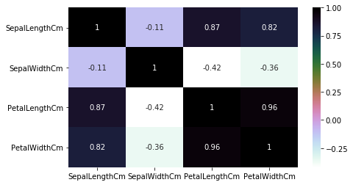
EDA – Heat Map

Slide 8
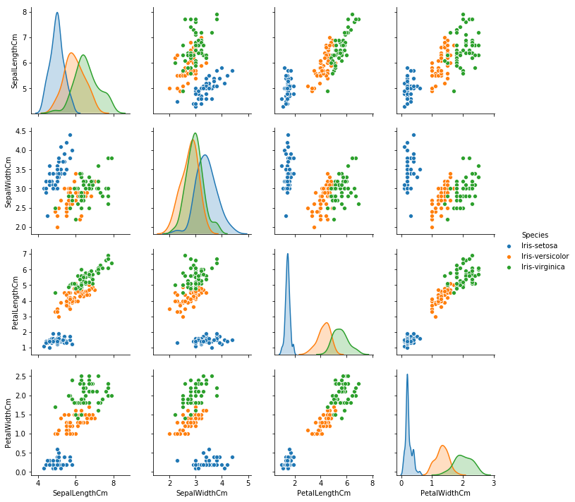
EDA - Pair Plot

Slide 9
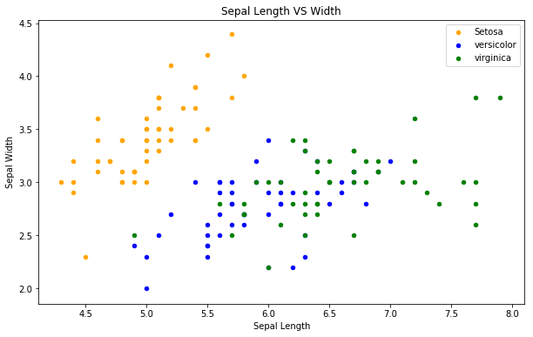
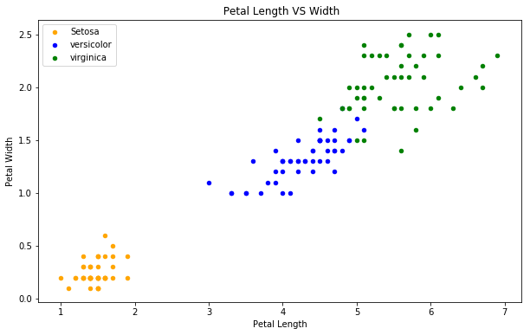
EDA – Scatter Plot

Slide 10
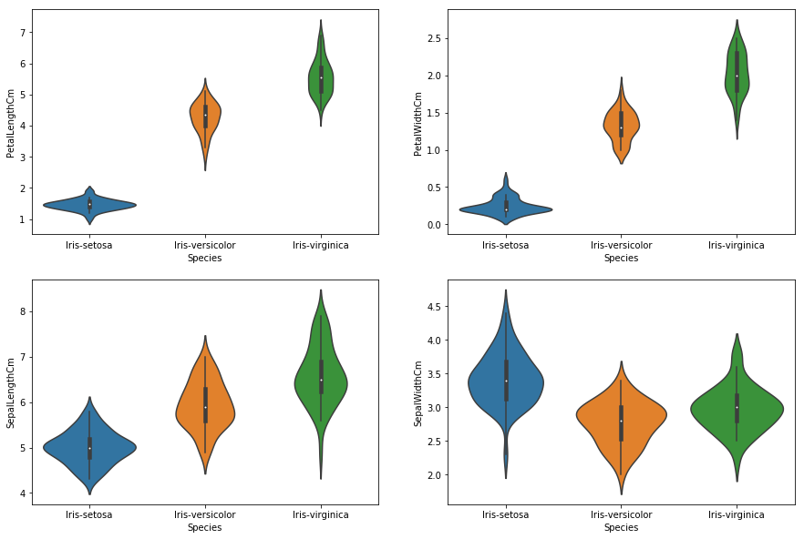
EDA – Violin Plot

Slide 11
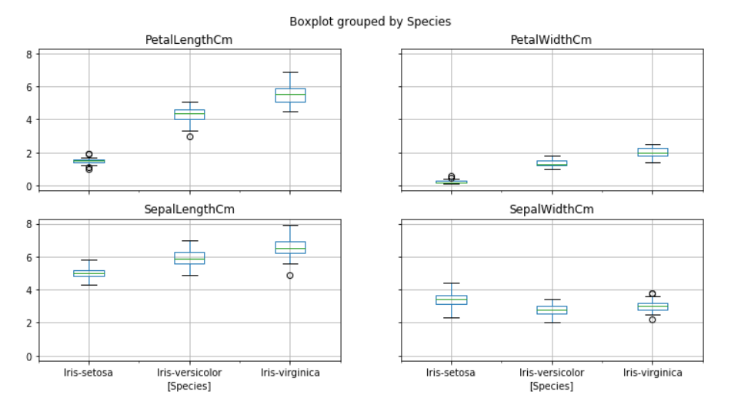
EDA – Box Plot

Slide 12
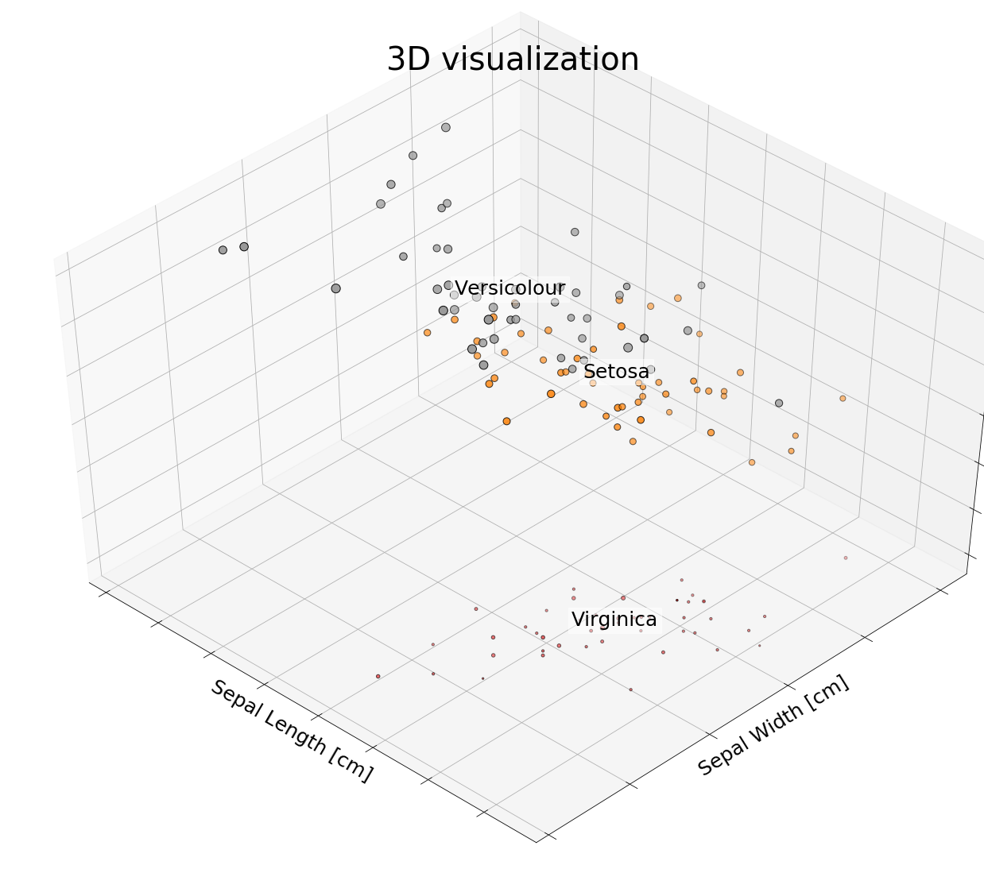
3D Visualization

Slide 13
Applying Machine Learning Algorithms

Slide 14
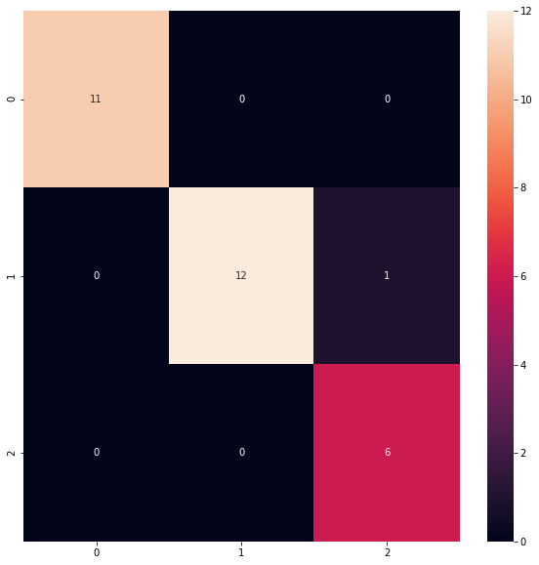

Logistic Regression Algorithm

Slide 15
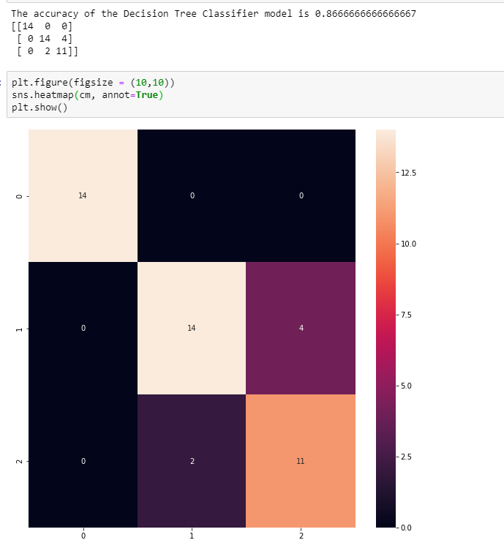
Decision Tree Algorithm

Slide 16

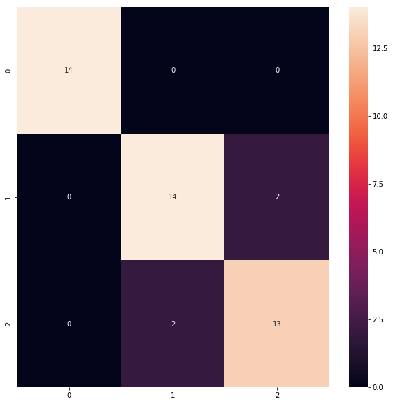
Random Forest Algorithm

Slide 17
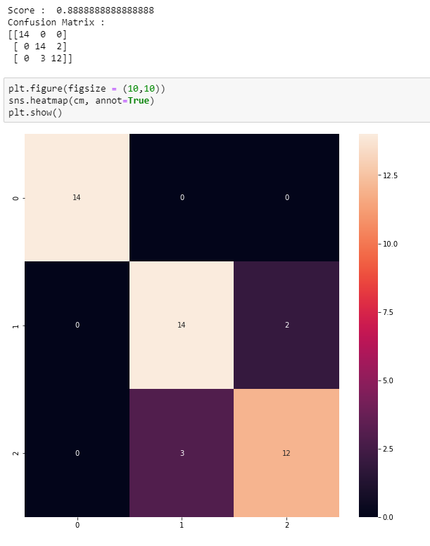
KNN Algorithm

Slide 18
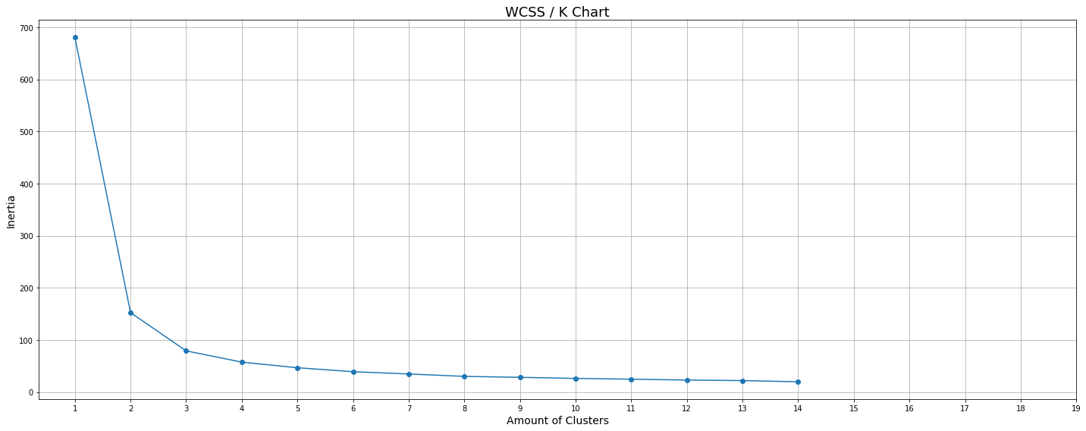
K Means – Elbow Curve

Slide 19
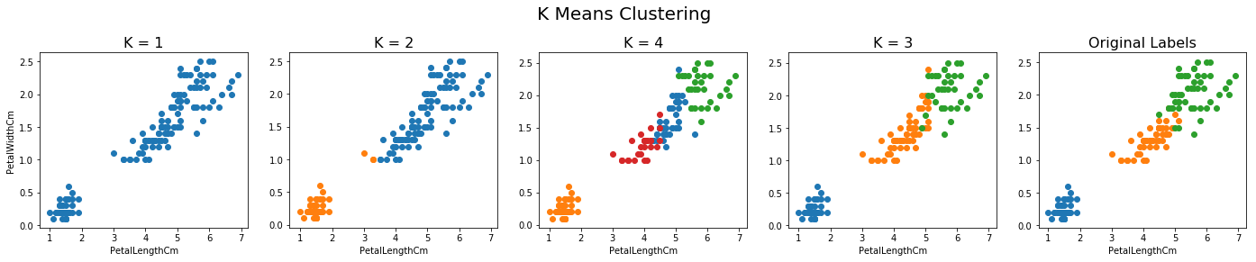
K Means Algorithm

Slide 20

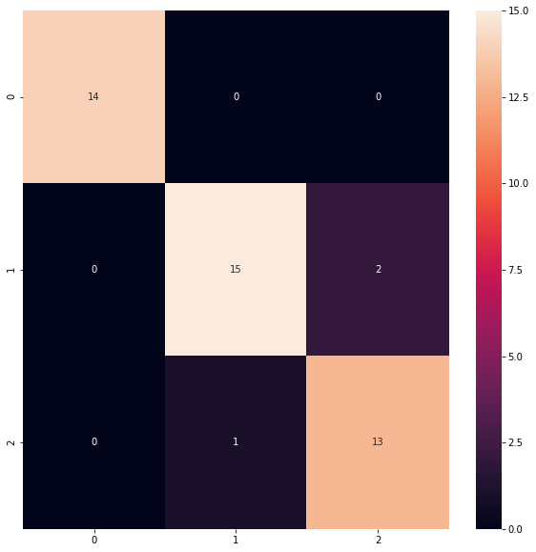
SVC Algorithm

Slide 21
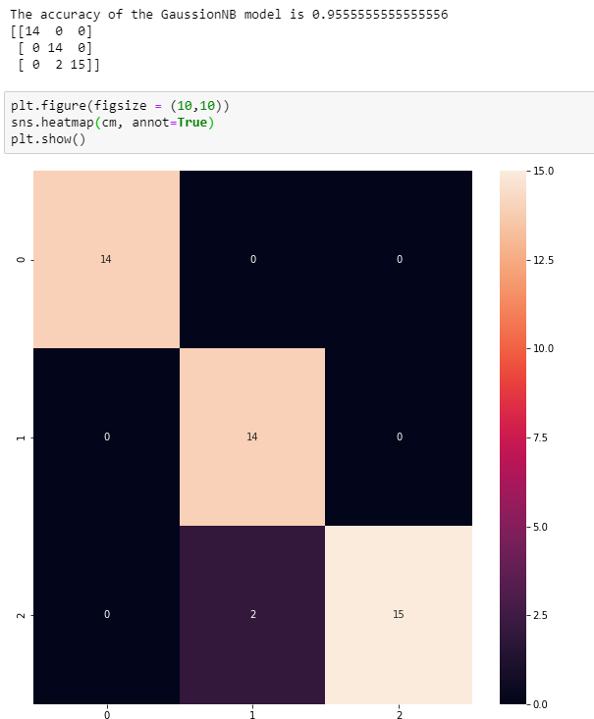
GaussionNB model

Slide 22
Conclussion
From above analysis we can conclude that Gaussian NB Model fits the best as the accuracy score is very high
K Means, SVC and Random Forest model also fit pretty well for Iris dataset

Slide 23
Thank You

